Slide 1
COVID-19 ANALYSIS
BY REGINA EDITH ARTHUR
ADVANCED DATA ANALYSIS

Slide 2
TABLE OF CONTENT
Topic Modelling
Directed and Undirected Graph Modelling
Time Series Modelling
Spatial Modelling

Slide 3
Topic Modelling

Slide 4
PIPELINE
Secondary Data Collection
Data Cleaning and Transformation
Topic Modelling with LDA
Key Findings and Insights

Slide 5
Secondary Data Collection
The dataset, originally published on Kaggle by Gabriel Preda, contains over 179,000 tweets collected through the Twitter API between March and April 2020. Each tweet includes:
The tweet text
User metadata (e.g., screen name, location, verification status)
Timestamps
Language and engagement metrics
For this project, a representative sample of 2,000 tweets was selected to balance computational efficiency with analytical depth.

Slide 6
Data Cleaning and Transformation
Data pre-processing was performed in R using base functions and packages such as textmineR, tm, and textclean.
Key pre-processing steps included:
Lowercasing all text
Removal of: URLs, punctuation and special characters, stopwords, words with less than three characters
Tokenization and lemmatization
Construction of a document-term matrix (DTM)
After pre-processing, the DTM consisted of 2,000 documents (tweets) and 3,442 unique terms

Slide 7
Topic Modelling with LDA
Latent Dirichlet Allocation (LDA) was applied to the pre-processed DTM to identify latent topics.
Multiple LDA models were trained with topic numbers k = 2, 4, 6, and 8 to evaluate model quality based on coherence scores.
Topic Coherence Evaluation
The model with six topics (k = 6) was selected as optimal due to its relatively high coherence, suggesting more interpretable and semantically meaningful topics.

Slide 8
Key Findings and Insights
Six main themes were identified from COVID-19 tweets using LDA: Public Health, Political Commentary, Medical Updates, Economic Impact, Global News, and Personal Sentiment.
Top keywords for each topic revealed distinct thematic clusters, such as "mask" and "safety" for public health, and "vaccine" and "trial" for medical updates.
Dominant topic classification allowed each tweet to be categorized by its most prominent theme, enhancing interpretability.
Word frequency analysis confirmed model validity, with high-frequency terms like "covid", "mask", and "vaccine" aligning closely with topic keywords.
Overall, the project demonstrated how LDA and R tools can effectively uncover meaningful structure in social media data on complex events like the COVID-19 pandemic.

Slide 9
Directed and Undirected
Graph Modelling

Slide 10
PIPELINE
Secondary Data Collection
Data Cleaning and EDA
Graphical Models Implementation
Key Findings and Conclusion

Slide 11
Secondary Data Collection
Data Source: WHO, ECDC, Johns Hopkins CSSE(Link: DataHub COVID-19 Dataset)
Key Variables: Confirmed cases, Deaths, Recovered cases
Format: Clean, normalized, country-level time series (CSV)
Why This Dataset? Reputable source, High inter-variable dependency, Well-suited for both Bayesian Networks (directed) & MRFs (undirected)

Slide 12
Data Cleaning and EDA
Removed rows with NA values in key columns
Performed descriptive statistics to understand distributions
Correlation Insights:
Confirmed–Deaths: Strong (0.92)
Confirmed–Recovered: Moderate (0.28–0.32)

Slide 13
Graphical Models Implementation
Directed Model (Bayesian Network):
Built with bnlearn using hill-climbing
Captures direct influence: Confirmed → Deaths
Query Result: P(Deaths > 1000 | Confirmed > 50,000) ≈ 0.90
Undirected Model (MRF):Derived by moralizing Bayesian network
Plotted using igraph
Offers symmetric co-dependency structure

Slide 14
Key Findings and Conclusion
Bayesian Network: Highlights conditional probabilities & potential causality
Markov Random Field: Focuses on joint distributions without directionality
Conclusion: Graphical models reveal interpretable relationships, Useful for pandemic preparedness and understanding dynamics

Slide 15
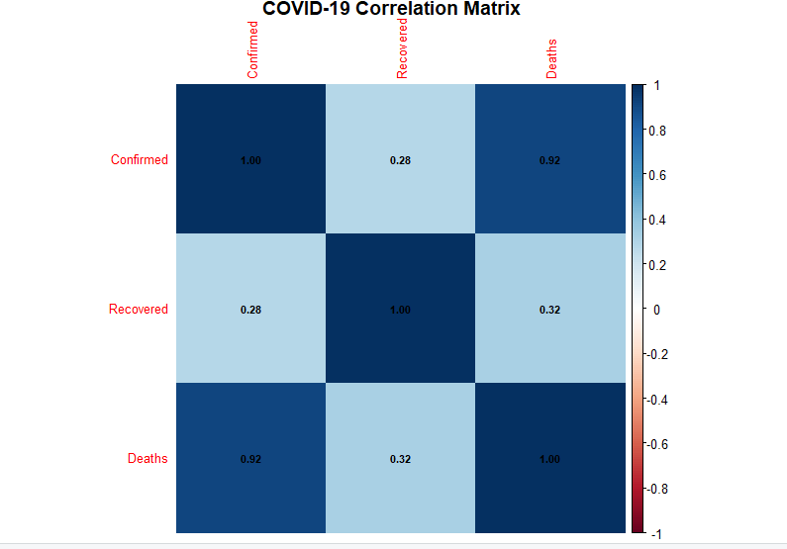

Slide 16
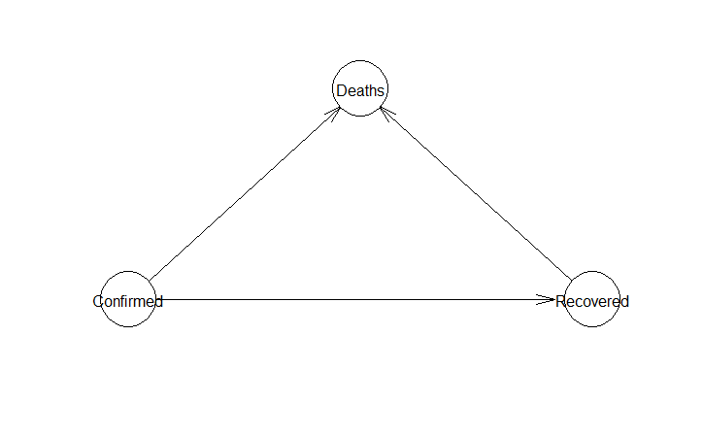

Slide 17
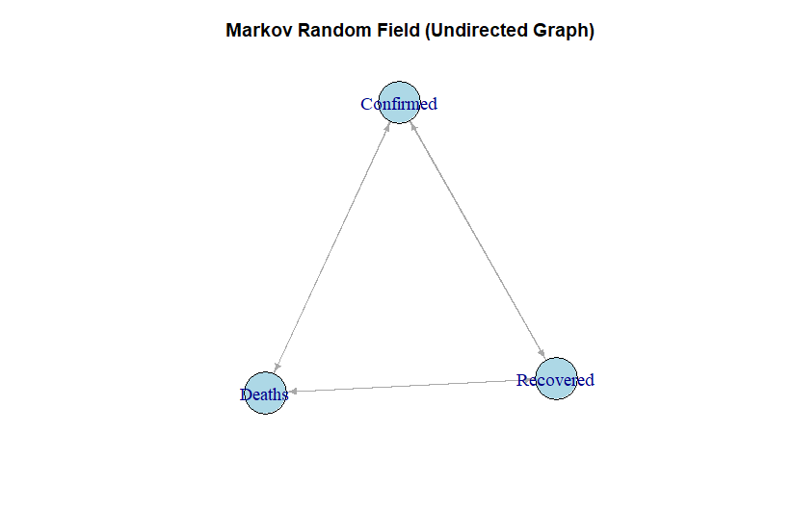

Slide 18
Time Series
Modelling

Slide 19
PIPELINE
Secondary Data Collection
Data Cleaning and Stationarity Analysis
Model Fitting and Diagnostics
Forecasting and Key Findings

Slide 20
Secondary Data Collection
Objective: Analyze and forecast global daily new COVID-19 cases using time series methods.
Dataset Source: WHO-COVID-19-global-data.csv
Time Period: Jan 3, 2020 – April 2025
Frequency: Daily
Variable of Interest: New_cases

Slide 21
Data Cleaning and Stationarity Analysis
Data Cleaning:
Corrected negative values
Replaced missing values with 0
Aggregated globally and formatted dates
Stationarity Tests:
ADF & PP Tests: Indicated stationarity
KPSS Test: Suggested non-stationarity
Action Taken: First-order differencing
Outcome: All tests confirmed stationarity after differencing

Slide 22
Model Fitting and Diagnostics
Model Selection: Informed by ACF & PACF
Suggested: ARIMA(5,0,5)
Model Fit : Applied to original series
All coefficients significant
Diagnostics : Ljung-Box
Test: Significant residual autocorrelation → structure remains

Slide 23
Forecasting and Key Findings
Forecast Horizon: 1 year
Findings:
High uncertainty (wide confidence intervals)
Captures broad seasonal patterns
Conclusion:
ARIMA models are useful but require cautious interpretation
Valuable for strategic planning, not precise predictions

Slide 24
SPATIAL MODELLING

Slide 25
PIPELINE
Secondary Data Collection
Data Cleaning and Transformation
Data Preparation for Spatial Modelling
Key Findings and Spatial Insights

Slide 26
Secondary Data Collection
COVID-19 Data:
Source: Humanitarian Data Exchange (HDX)
Details: Region-level confirmed cases, deaths, gender breakdown (Mar 2020 – May 2021)
Population Data:
Source: UNFPA via HDX
Details: 2021 regional population estimates for case normalization and comparisons
Shapefile:
Source: GeoBoundaries
Details: Defines administrative boundaries of Ghana's 16 regions

Slide 27
Data Cleaning and Transformation
Standardized column names and fixed inconsistencies across datasets.
Removed records with undefined or invalid regional data.
Verified and aligned coordinate reference systems across spatial layers.
Aggregated total confirmed cases and deaths at regional level.
Matched shapefile region names with tabular data for seamless joins

Slide 28
Data Preparation for Spatial Modelling
Used tmap to generate choropleth maps of regional cases:
Observed high concentrations in Greater Accra and Ashanti regions
Created spatial weight matrix using queen contiguity to define neighbours.
Detected spatial clustering, justifying use of spatial lag model (lagsarlm)
Built regression model:
Dependent variable: Total COVID-19 cases
Independent variable: Regional population
Model feature: Accounts for spatial autocorrelation in outcomes

Slide 29
Key Findings and Spatial Insights
Strong positive correlation between population size and reported cases
Southern regions showed spatial clustering of high case counts (urban density & mobility)
Residual maps indicated: Potential underreporting in Northern and Volta regions Or regional factors (testing access, reporting gaps) influencing patterns.
Findings support targeted interventions:
Focus on urban centres for testing, resources, vaccination
Monitor discrepancies in low-reporting regions

